Slide 1
Groups 1 - the Alkali Metals

Slide 2
starter
What is the name of the group 1 elements?
Name 3 of these elements.
If one of these elements has the symbol and atomic number and mass
Na
What are the number of protons, neutrons and electrons in this atom?
What is the electron arrangement in this atom and how do we know what group we should place it in?
23
11

Slide 3
answers
What is the name of the group 1 elements?
Name 3 of these elements.
If one of these elements has the symbol and atomic number and mass
Na
What are the number of protons, neutrons and electrons in this atom?
What is the electron arrangement in this atom and how do we know what group we should place it in?
Alkali metals
Lithium, sodium, potassium, rubidium, caesium, francium
Protons = 11
Neutrons = 12
Electrons = 11
2,8,1
Placed in group 1 as the atom has one electron in its outer shell
23
11

Slide 4
Walt and WILF
WALT
Different elements have different properties related to their position in the Periodic Table
WILF
Locate the position in the Periodic Table of the alkali metals.
Recall how the alkali metals react with water and how this reaction changes as we travel down the group.
Recall whether these reactions are endothermic or exothermic.

Slide 5
Group 1 – The alkali metals
Li
Na
K
Rb
Cs
Fr

Slide 6
Representative Elements
Groups 1 and 2
Groups 1 and 2 are always found in nature combined with other elements.
They’re called active metals because of their readiness to form new substances with other elements.
They are all metals except hydrogen, the first element in Group 1.
Although hydrogen is placed in Group 1, it shares properties with the elements in Group 1 and Group 17.

Slide 7
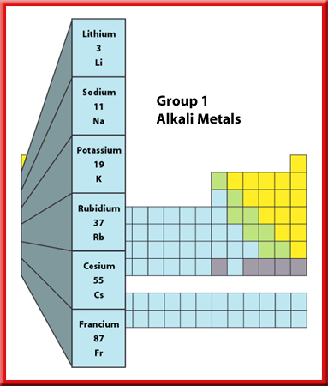
Alkali Metals
The Group 1 elements have a specific family name—alkali metals.
All the alkali metals are silvery solids with
low densities and low melting points.
These elements increase in their reactivity, or tendency to combine with other substances, as you move from top to bottom.

Slide 8
Walt and WILF
WALT
Different elements have different properties related to their position in the Periodic Table
WILF
Locate the position in the Periodic Table of the alkali metals.
Recall how the alkali metals react with water and how this reaction changes as we travel down the group.
Recall whether these reactions are endothermic or exothermic.

Slide 9
Group 1 – The alkali metals
Some facts…
1) These metals all have ___ electron in their outer shell
2) Reactivity increases as you go _______ the group. This is because the electrons are further away from the _______ every time a _____ is added, so they are given up more easily.
3) They all react with water to form an alkali (hence their name) and __________, e.g:
Potassium + water potassium hydroxide + hydrogen
2K_{(s)} + 2H₂O_{(l)} 2KOH_{(aq)} + H_{2(g)}
Words – down, one, shell, hydrogen, nucleus

Slide 10
Plenary 1.
Predict
What would happen if rubidium was added to water.
1. how fast will it react?
2. Will it be endothermic or exothermic?
3. What gas will be formed?
4. What would be the word equation

Slide 11
Plenary 2.
Predict
What would happen if caesium was added to water.
1. how fast will it react?
2. Will it be endothermic or exothermic?
3. What gas will be formed?
4. What would be the word equation?

Slide 12
This powerpoint was kindly donated to www.worldofteaching.com
http://www.worldofteaching.com is home to over a thousand powerpoints submitted by teachers. This is a completely free site and requires no registration. Please visit and I hope it will help in your teaching.

